Slide 1

Changing the Physics of Defense How modern defenders are re-writing the conventional wisdom of infosec
John Lambert, @johnlatwc
General Manager, Microsoft Threat Intelligence Center

Slide 2


Conventional Wisdom in Defense
Traditional Defenders |  | Modern Defenders
Defend a list of assets |  | Defend a graph of assets
Manage incidents |  | Manage adversaries
Minimize risks by keeping incidents secret |  | Maximize learning by sharing incidents with trusted outside peers
View pentest results as a report card |  | View pentest results as an input
Think about stopping attacks |  | They think about increasing attacker requirements

Slide 3
3 Ways Modern Defenders are Different
They “Assume Breach” and think in graphs, not lists
They manage adversaries, not incidents
They are full stack defenders

Slide 4
Mindset
>> They “Assume Breach” and think in graphs, not lists
They manage adversaries, not incidents
They are full stack defenders

Slide 5
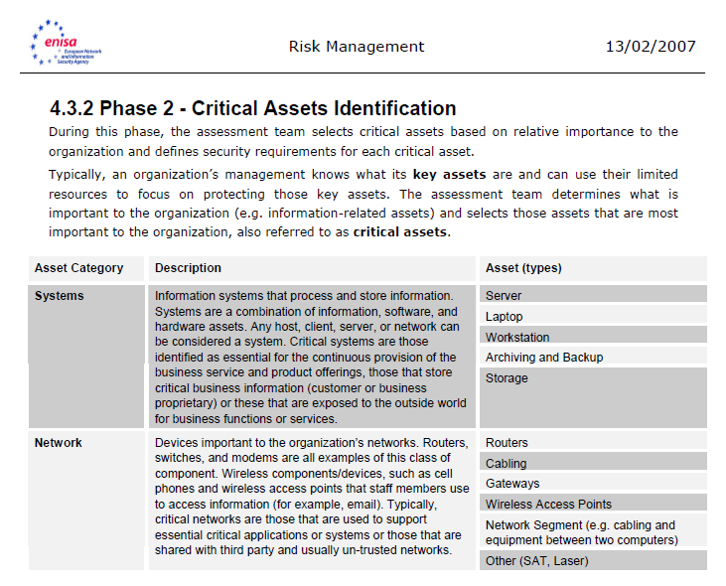
How to view the battlefield?
What are the most important assets?
Domain controllers
Certificate authorities
Admin accounts
Source control servers
Databases
…
How can we identify these assets?
Asset inventories
BCDR processes
Compliance certifications require lists

Slide 6




As long as defenders think in lists and attackers think in graphs, attackers win
This is an important account
…Which logs in a on a server
…Which has other admins
Password
ABC123DE
AF34DF56D…
…Who log on to other servers
NTLM Hash
NTLM
Kerberos TGT
TGT

Slide 7
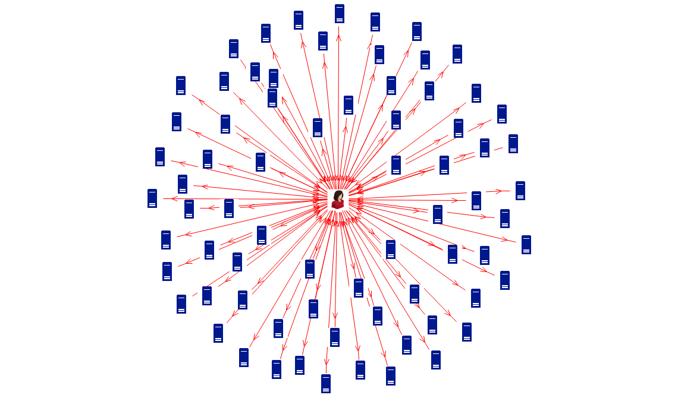
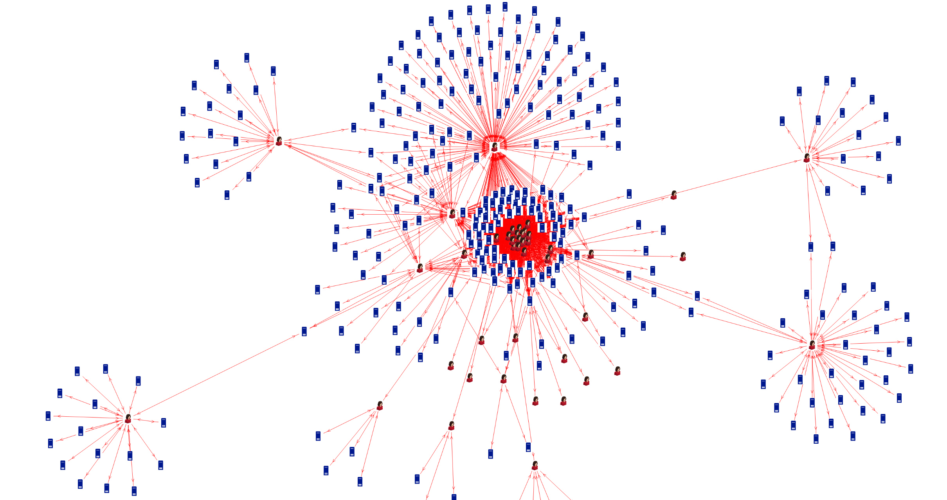
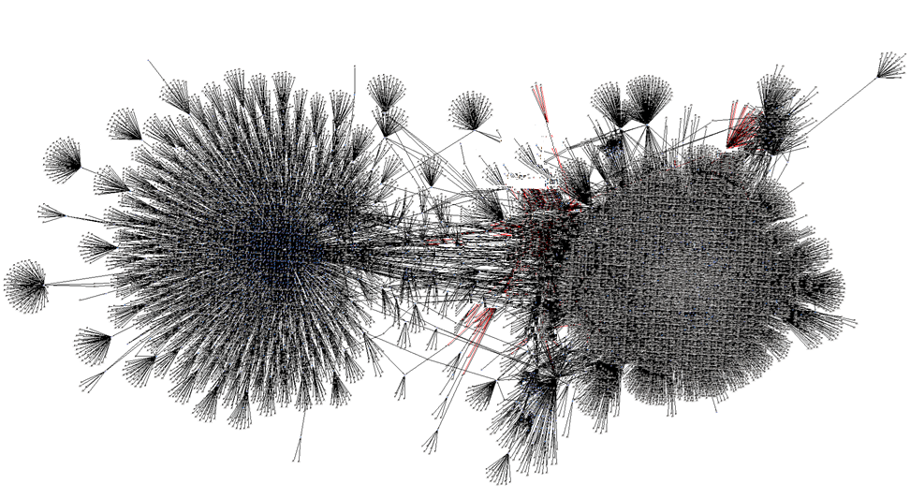

Slide 8
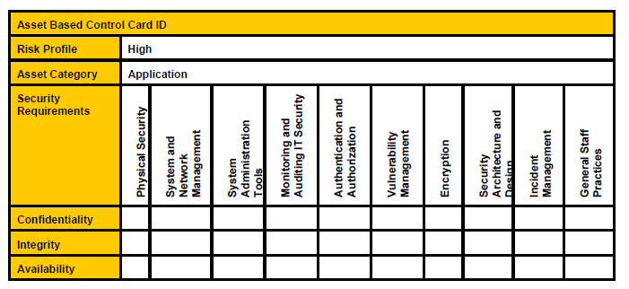
How is the graph created?
Edges
Dependencies
Control relationships
User behavior patterns
Security controls
Dynamic edges
0-days and unpatched vulns
Credential re-use
Realize that logons create edges
Logons spread credentials
Demote the protection of the credentials to the security of the host
Example ENISA Asset Control Card

Slide 9
Manage Adversaries
They “Assume Breach” and think in graphs, not lists
>> They manage adversaries, not incidents
They are full stack defenders

Slide 10

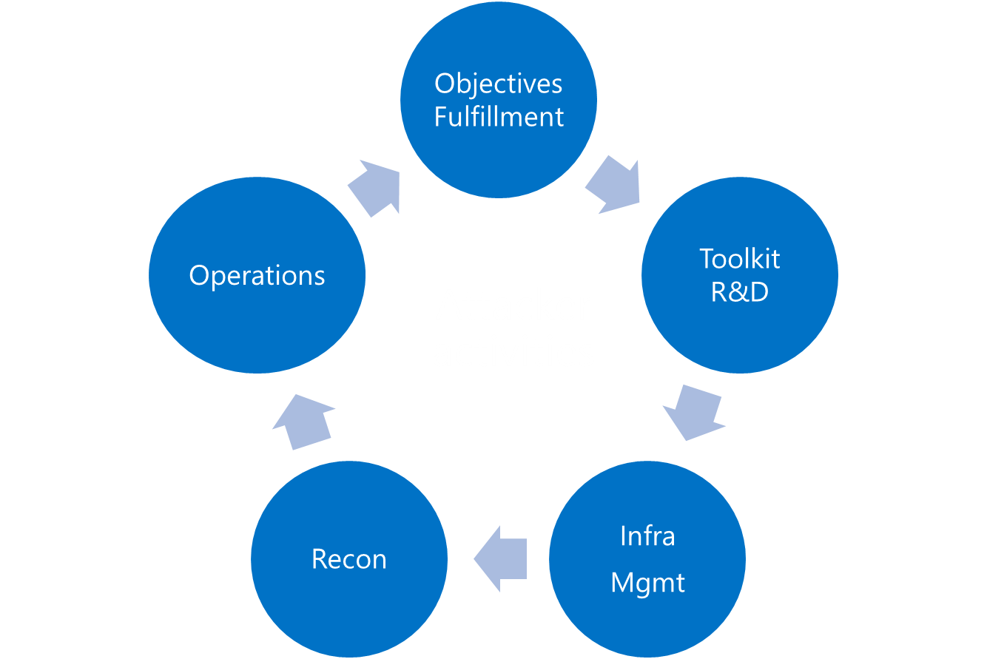
Learning from Intrusions
Adversary
Infrastructure
Capabilities
Victim
Reconnaissance
Weaponization
Delivery
Exploitation
Installation
C2
Actions on Intent
Reconnaissance
Weaponization
Delivery
Exploitation
Installation
C2
Actions on Intent
Reconnaissance
Weaponization
Delivery
Exploitation
Installation
C2
Actions on Intent
Diamond Model: http://www.activeresponse.org/the-diamond-model/ Kill Chain: Lockheed Martin

Slide 11
Master the Attacker Graph
Discover the attacker graph
Capture attacker activity
Use analytics, threat intel, and hunting (e.g. yara) to reveal edges and nodes
Analyze forwards and backwards
Share the graph to put the picture together
Manipulate edges and nodes
Remediation
Re-write edges and nodes (MITM, sinkholes)
Shape their graph
Deny access to certain kinds of edges and vertices (MFA, JIT, whitelisting)
Focus on the scarcest edges, the most long-lived edges, and the most connected edges

Slide 12
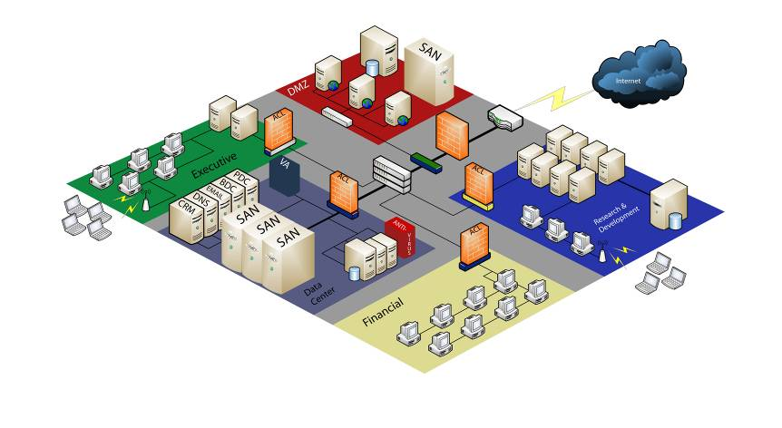
Imprison attacker activity
Certificate Authority Logs
2
…we need all these logs
Host scanning results
VPN Logs
Firewall Logs
Vulnerability Assessment results
1
Web Proxy Logs
Event log data
To protect this critical data…
Wireless logs
Network IDS results
Critical business data
Netflow
Crash reports
Security Scan results
Window Domain Logins
Remote Access Logs
DHCP Logs
Anti-virus Logs
Account / Group Membership Logs

Slide 13
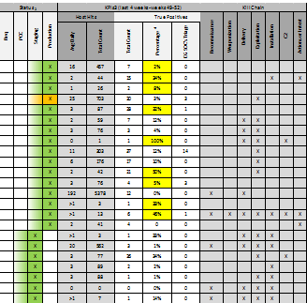
The Defender Pyramid
Adversary
KPIs and results
Infrastructure
Activity
Objectives
Production
Lifecycle
Attack Lifecycle Phase
Network
Threat Indicators
FW/Proxy
DNS
VPN/DA
NetFlow
AV
NIDS
Detonation
Application Logs &
Accesses
Host
Authentication logs
Access logs
Application Logs
Event Logs
Agent Logs
“It’s not the spider’s bite that makes it successful—it’s the web”

Slide 14
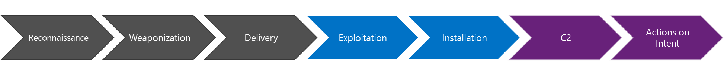

Time Travel Breach Detection
Or here
Or here
Or here
Or here
Or here
Or here
Activity Level
Find them here
Time

Slide 15
Modern defenders share their graphs
Tech industry, defense contractors, ISPs, gov, cloud hosters, …
They manage equities well
TLP protocol
Give credit
Respect equities
They work to get victims notified and protected
They share without any immediate expectation of payback

Slide 16
Outcomes from Sharing
Participants get a net intel gain in the form of samples, knowledge, and know-how.
Adversary is forced back into a development cycle to compensate for improved antimalware coverage, shut-down infrastructure, and invalidated TTPs.
Threat Intel Gain
The coordinated “muscle” built during deliberate operations is invaluable in emergency situations as well.
Temporary Adversary Reset
Improve Coordinated Action
Publicity can rally industry threat intel analysts on intrusion activity that has lurked under the radar.
Increased Impact
Increased Level of Effort
Increased Difficulty Measuring
Promote Adversary Coverage
Nothing in the world of cyber gets better unless victims start defending themselves better.
Awaken Victims

Slide 17
Full Stack Defenders
They “Assume Breach” and think in graphs, not lists
They manage adversaries, not incidents
>> They are full stack defenders

Slide 18
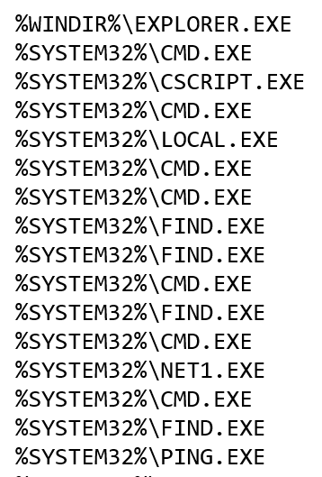
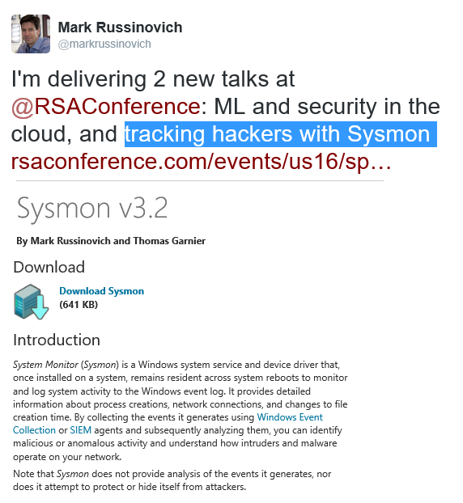
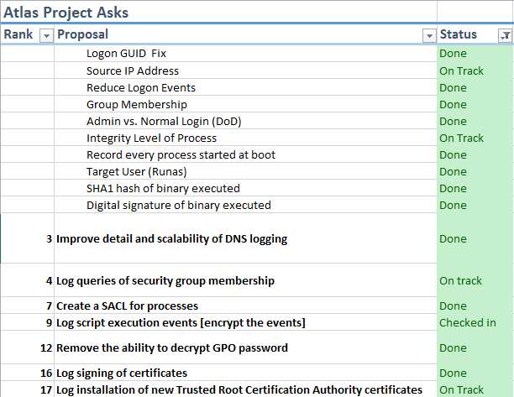
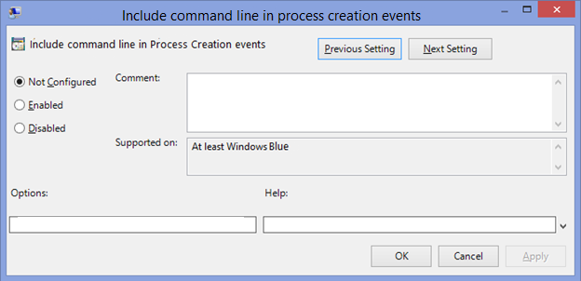
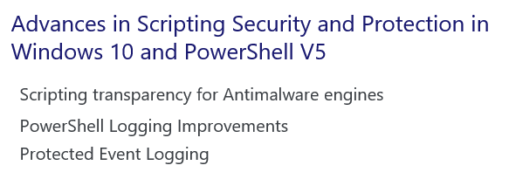
Engage the Adversary Across the Entire Lifecycle
Reconnaissance
Weaponization
Delivery
Exploitation
Installation
C2
Actions on Intent
net view \\10.0.1.2
nbtstat -a 10.0.3.4
ping jumpbox01
ping jumpbox02
ping jumpbox03
net view \\10.1.0.1
ping admin-win7box
local administrators \\admin-win7box
net use x: \\admin-win7box /user:domain\backupacct
net use x: /del
net user backupacct /domain

Slide 19
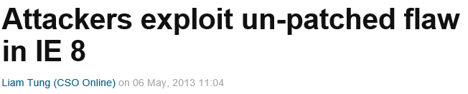

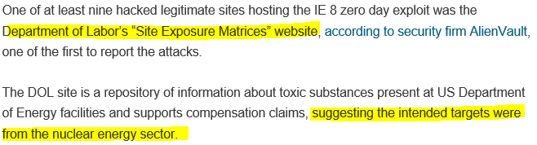
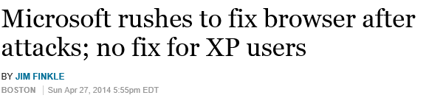

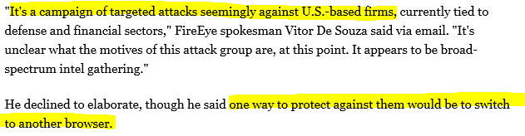
Engage the Adversary Across the Entire Lifecycle
Reconnaissance
Weaponization
Delivery
Exploitation
Installation
C2
Actions on Intent
Use heap spraying or massaging to place an array length at a predictable location
Leverage a memory corruption issue to modify the array length, enabling arbitrary read/write
Use the arbitrary read/write to discover the address of a DLL in memory
Construct a ROP payload by searching for code sequences in the DLL
Corrupt a C++ virtual table pointer and trigger a virtual method call to first ROP gadget
Execute the ROP payload (typically to make shellcode executable)
Execute arbitrary native code
Escape the sandbox – or do what they need to inside the sandbox
Memory Protector
MemGC
Type Protect
Attack surface reduction
Isolated Heap
64-bit by default
Control Flow Guard
Stack randomization
Code integrity & no remote DLL
AppContainer

Slide 20
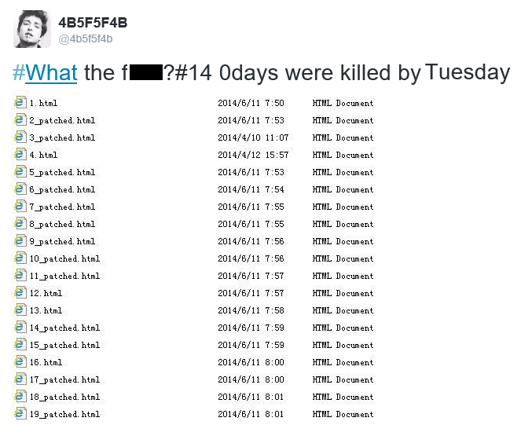
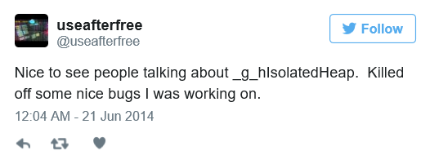
Engage the Adversary Across the Entire Lifecycle
Reconnaissance
Weaponization
Delivery
Exploitation
Installation
C2
Actions on Intent
Number of days with known zero day exploit in the wild
Number of days with known Microsoft web browser Remote Code Execution (RCE) zero day in the wild before patch
No known zero day exploit for a Microsoft RCE CVE that works against IE11 on Windows 8.1+ for 19 months
No known exploits in-the-wild that target Edge
75% reduction in RCE CVEs that affect Edge in the first 5 servicing months

Slide 21
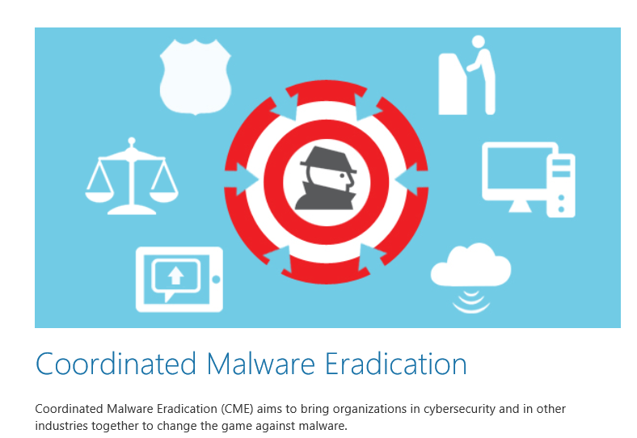
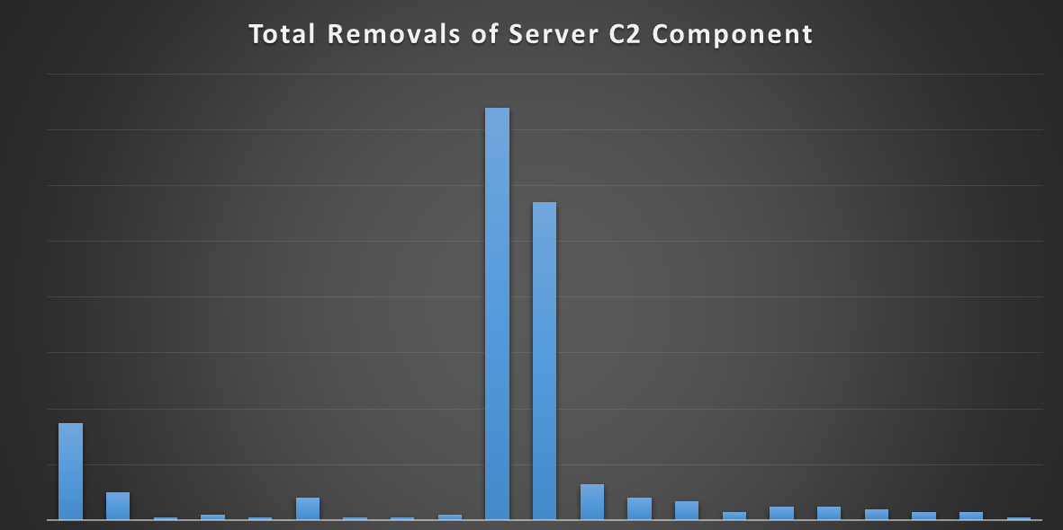
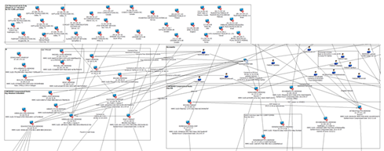
Engage the Adversary Across the Entire Lifecycle
Reconnaissance
Weaponization
Delivery
Exploitation
Installation
C2
Actions on Intent
MSRT
SCEP

Slide 22
Summary
Imprison attacker activity
Share and discover the attacker graph
Be a full stack defender
Coordinate and disrupt
Awaken more defenders

